Slide 1
A Methodology for Encoding
Mensural Music:
Introducing the Mensural MEI Translator
Karen Desmond, Brandeis University
Martha E. Thomae, McGill University
Universitat Pompeu Fabra
Barcelona, May 22nd, 2017

Slide 2
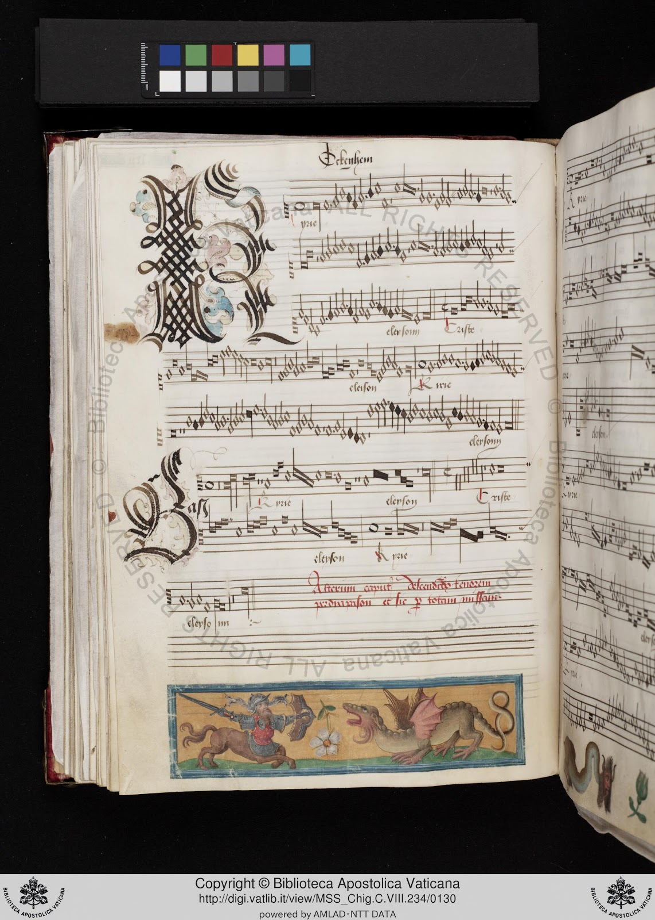
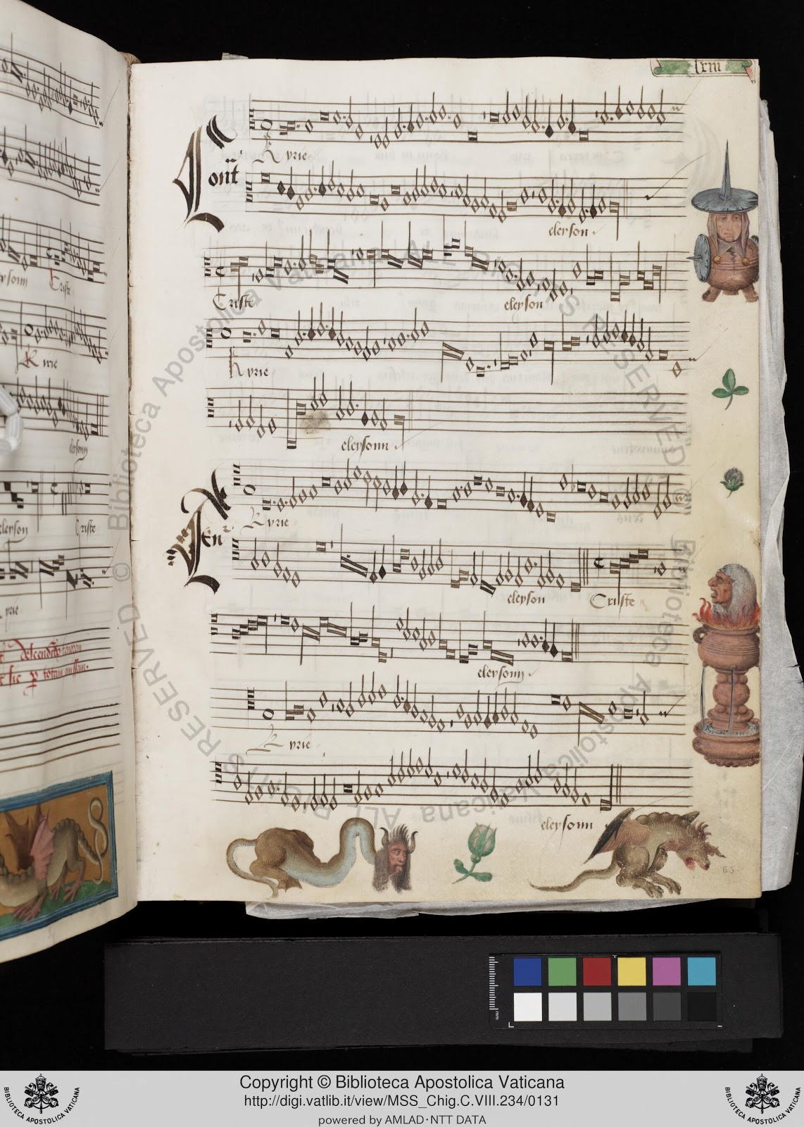
Notes:
Mensural music looks like this…
Its name is due to the use of this different system of notation, called mensural notation
Which was used in the Late Middle Ages and the Renaissance
Goal: to encode this music in a machine-readable format that encoded its original (mensural) values
Very few formats that provide support for mensural notation
One of them is MEI,
which stands for Music Encoding Initiative.
XML-based symbolic format, just like MusicXML
But MEI, in contrast to MusicXML, is a community-based effort to define the best practices to encode a wide variety of musical documents,
SO IT PROVIDES SUPPORT FOR OTHER NOTATION SYSTEMS OTHER THAN CMN, including these kind of documents.
Goal: encode these pieces into Mensural MEI files
Hand-coding → inefficient,
Thinking about a methodology to faciliate this process.

Slide 3
And how can we get them encoded into Mensural MEI files?
What is the best way to get musicologists to enter a large amount of musical documents into the computer?
Notes:
In this paper we present a methodology that accomplishes this task, in part through a tool we developed called

Slide 4
The Mensural MEI Translator
Notes:
The Mensural MEI Translator.

Slide 5
A straightforward method to encode music repertories from the later Middle Ages and the Renaissance
as they were originally notated.
Notes:
Which offers a straighforward . . . (click for last phrase of sentence to appear). This methodology allows musicologists to use a score editor that they are already familiar with (i.e. Sibelius), and then this file is submitted through a couple of processes to convert it into mensural MEI. However, before explaining how the translator works, for a few of you anyway, perhaps a quick refresher of mensural notation would be useful.

Slide 6
Mensural Notation 101

Slide 7
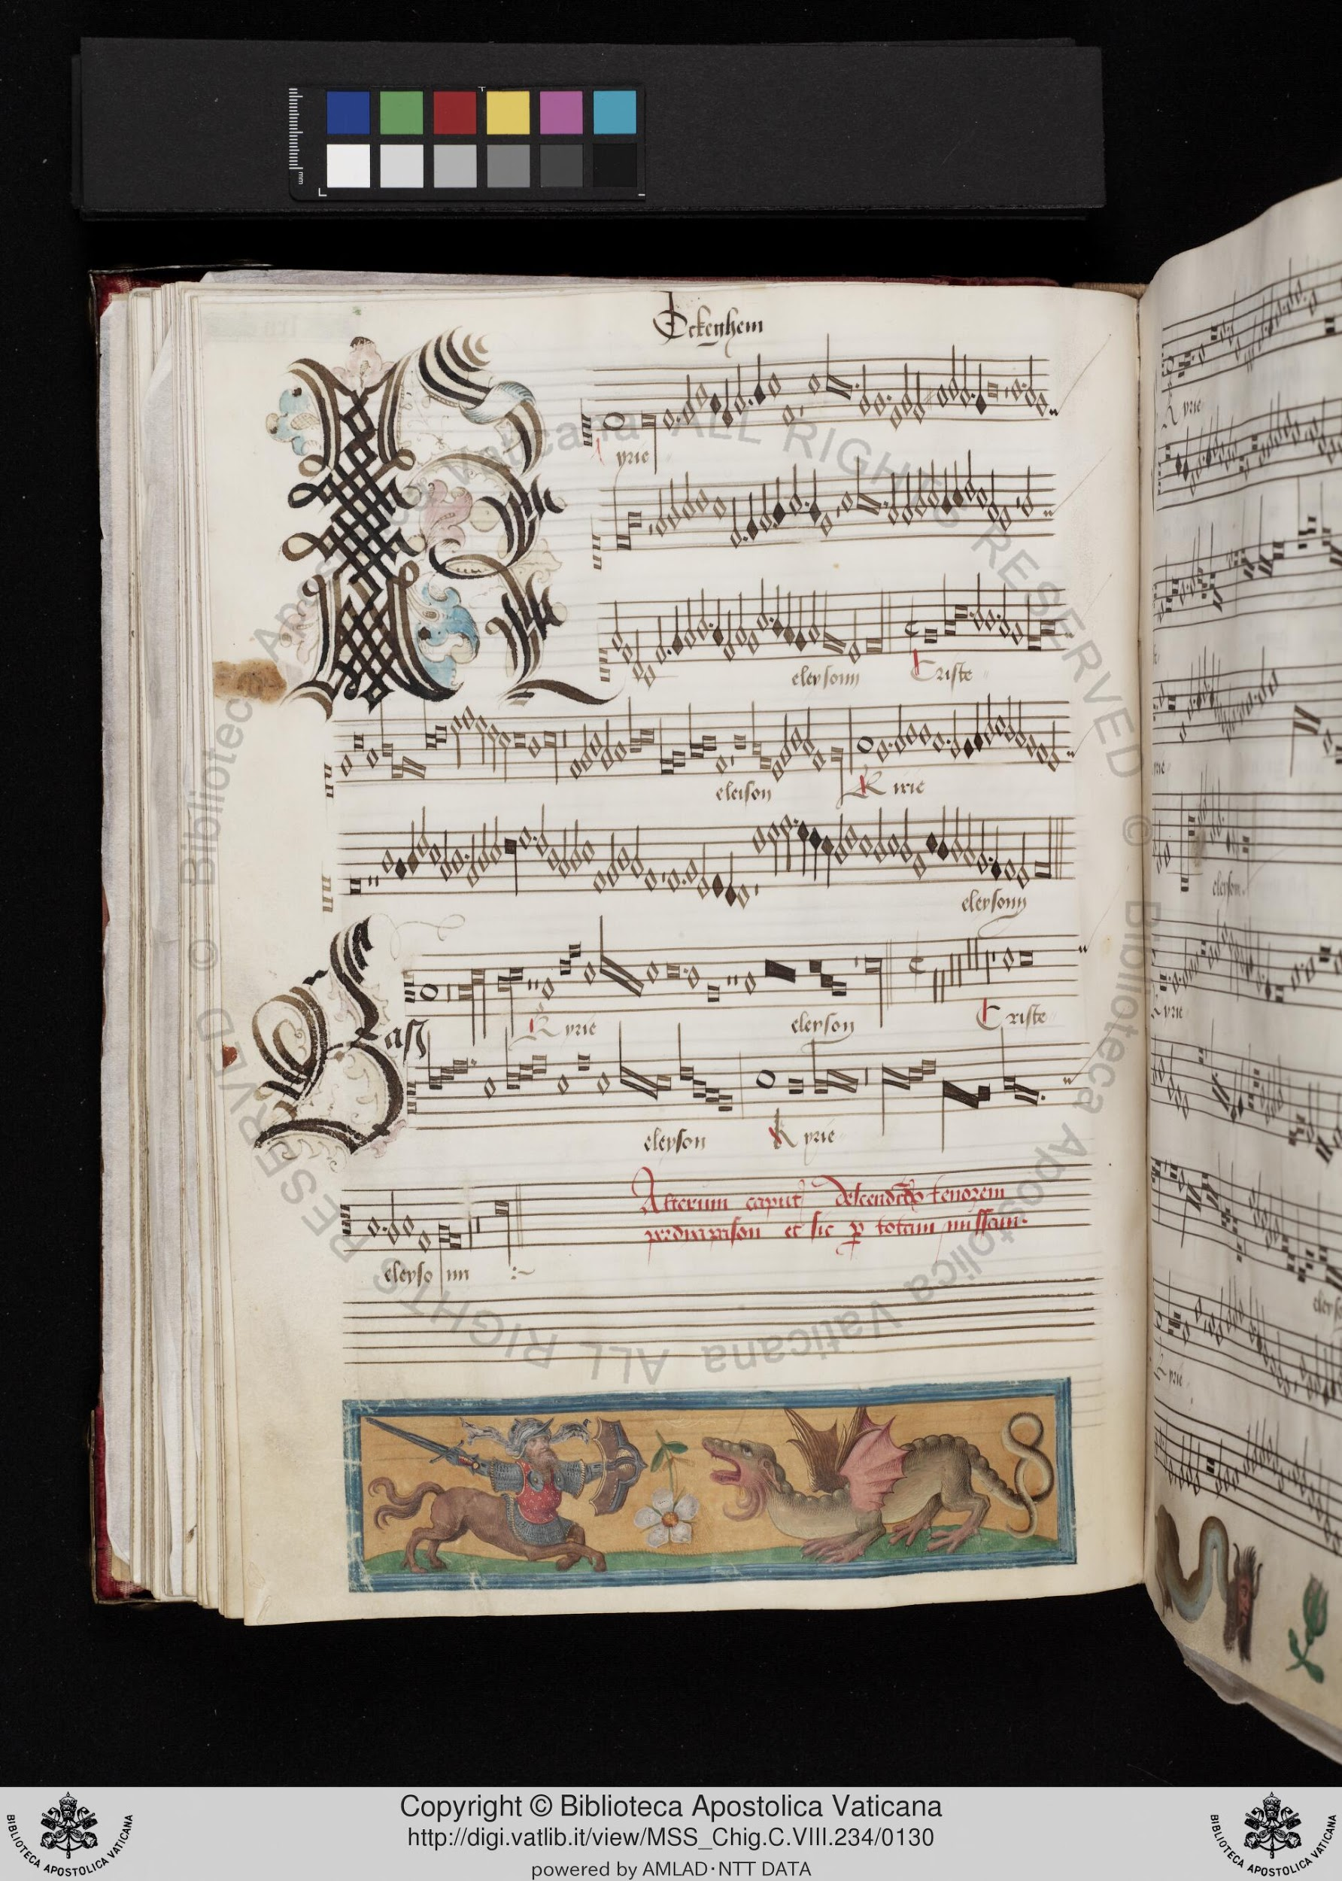
Mensural Notation
System of notation used from the 1250s to 1600s
Looks similar to our common Western music notation (CMN):
Already uses staff-lines and clefs to indicate pitch
Mensural note-shapes are similar to CMN note-shapes
Modern Notes
(White) mensural notes
Notes:
In the second half of the thirteenth century techniques for specifically indicating rhythmic duration were developed, a notation called ‘mensural’ or ‘measurable.’ Almost all polyphonic music from 1300-1600 is notated in mensural notation, the rules of which changed little from c. 1350.

Slide 8
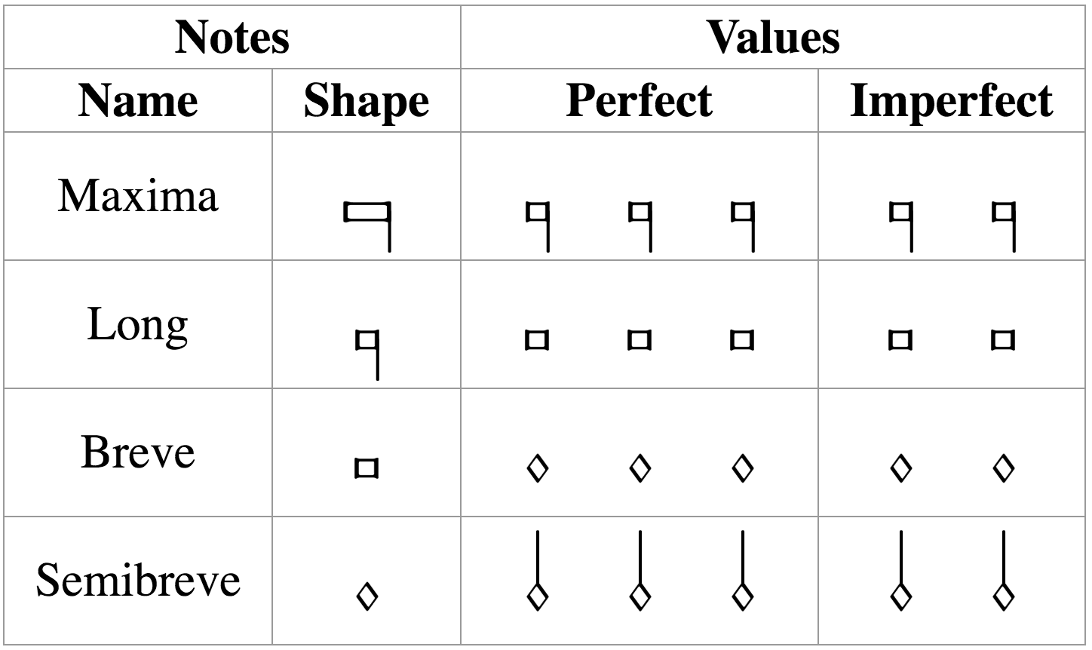
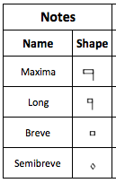
Mensural Notation
The note-shapes are similar and there is a clear hierarchy in the note duration
longest
But, the actual value of these notes is ambiguous
shortest
It can either be triple (i.e., “perfect”) or duple (i.e., “imperfect”)
The value is determined by two factors:
Mensuration
Context
Notes:
[third bullet] Mention: “perfect” for the Holy Trinity (so people remember the terms “perfect” and “imperfect”
[SAME, end of third bullet] In the same piece, moreover, in the same voice, the same note can be used with two different values
[Mensuration] IT WILL TELL YOU BY DEFAULT THE VALUE OF THOSE FOUR NOTES, WHETHER IT WILL BE PERFECT OR IMPERFECT
[Context] EXCEPTIONS TO THAT DEFAULT VALUE
There are certain principles on how context affects the note value. I am not going to enumerate all of these principles, but I will give an example of the general idea of on how these principles work.

Slide 9
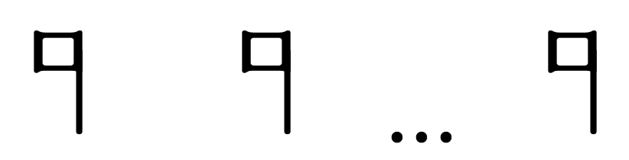
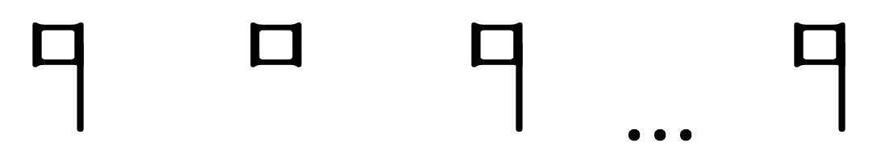

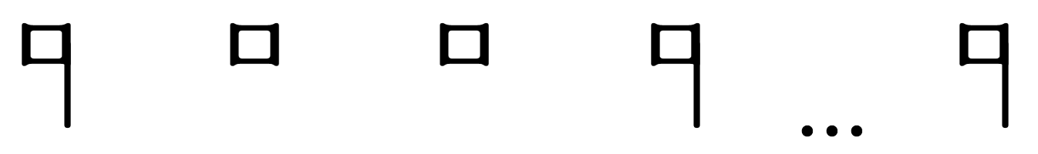

Examples of Context Changing the Note’s Value
Mensuration: modus (longs) = 3 → Longs are perfect by default
Perfect → Imperfect
Alteration
x 2
Notes:
Mensuration
Series of perfections
Not one-to-one correspondence between note-shape and note-value

Slide 10
Methodology for Encoding
Mensural Music
Notes:
So, back to our proposed methodology for encoding mensural music

Slide 11
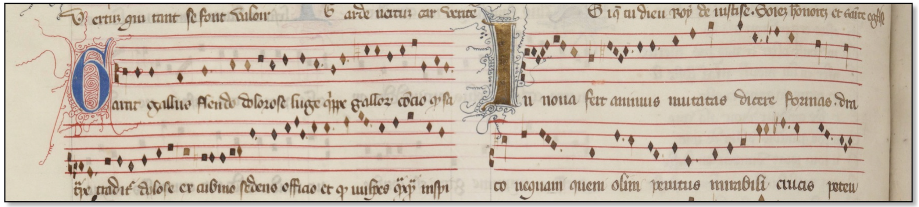
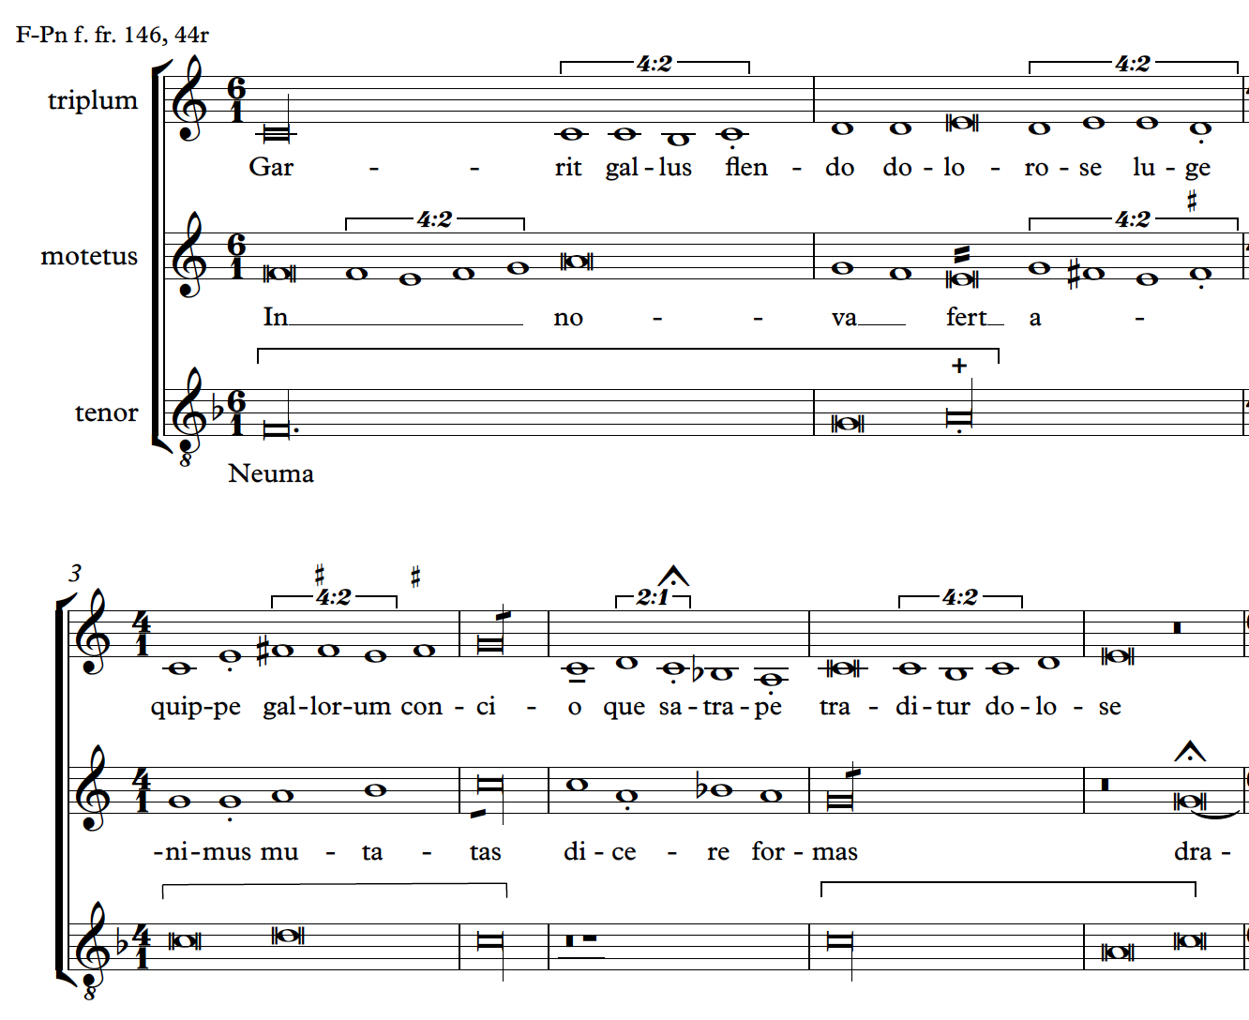
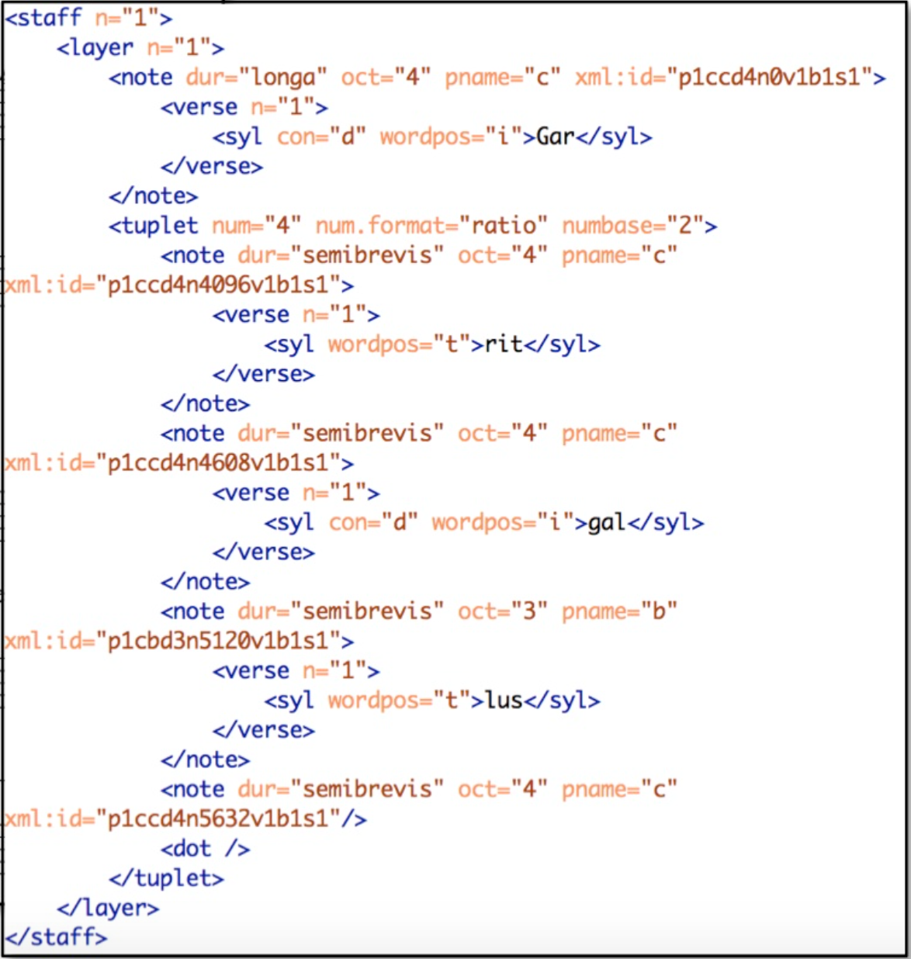
Methodology
Mensural MEI
Document
Common Music Notation MEI
Opening of the motet Garrit gallus / In nova from the manuscript Paris, Bibliothèque nationale, f. fr. 146.
Notes:
3-step methodology
Modern values → Sibelius
Sibeliius, whiy? Plugin
CMN MEI → the transcription
not the original manuscript
Then, third step: Mensural MEI doc.

Slide 12


Methodology
Sibelius
file
(modern transcription)
CMN
MEI
file
Mensural
MEI
file
SibMEI
plugin
Mensural MEI
Translator

Slide 13
Step 1: Transcribe
Sibelius
file
(modern transcription)
Modern transcriptions usually do not record all the features contained in the mensural sources
We developed a system of articulation marks to represent specific mensural notation features in the Sibelius transcriptions

Slide 14
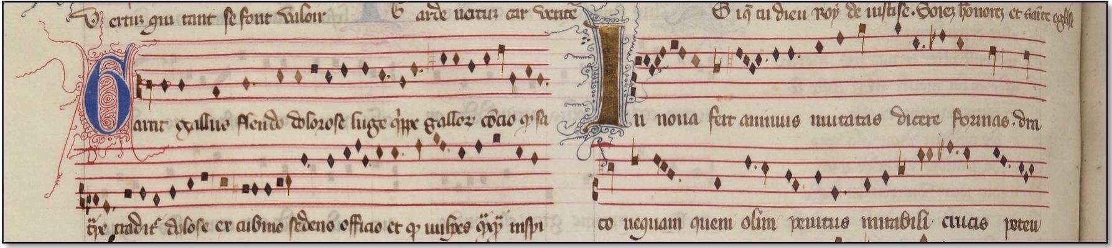
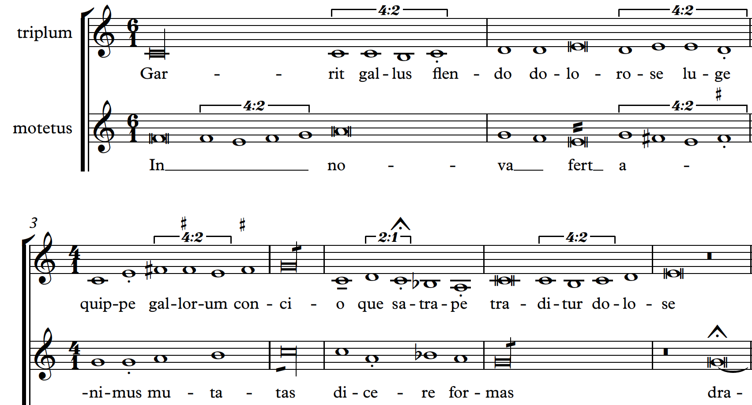
Opening of the motet Garrit gallus / In nova from the manuscript Paris, Bibliothèque nationale, f. fr. 146.
Notes:
Dots, modern: effect, not the presence
HACK
Does not mean anything
Is a way to enter metadata into the file

Slide 15
Repertoire for first phase of ‘Measuring Polyphony’ project
64 polyphonic pieces representing:
Ars antiqua (c. 1280–1320):
Montpellier Codex (Montpellier, Bibliotheque interuniversitaire, Section de medecine, H. 196)
Roman de Fauvel manuscript (Paris, Bibliotheque nationale, f. fr. 146)
Brussels rotulus (Brussels, Bibliotheque royale, Ms. 19606)
Ars nova (c. 1320–1350):
Ivrea Codex (Ivrea, Biblioteca capitulare, Ms. 115)
Notes:
2 periods of mensural notation
Dealt different in the interpretation of certain notes

Slide 16
Step 2: Convert into MEI
Sibelius
file
(modern transcription)
CMN
MEI
file
SibMEI
plugin

Slide 17
Step 3: The Mensural MEI Translator
CMN
MEI
file
Mensural
MEI
file
Mensural MEI
Translator

Slide 18
Three actions
Decodes the articulation marks we introduced in Sibelius
Changes the CMN note names to the corresponding mensural note names
Determines and encodes the quality (perfect / imperfect) of the note within the <note> element
Notes:
The SECOND refers to the note SHAPE
The THIRD refers to the QUALITY (P/I) of the note

Slide 19
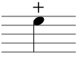
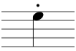
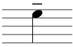
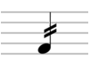
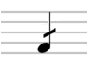
1. Decode the Sibelius marks
Mensural feature | Sibelius | CMN MEI | Mensural MEI
Alteration |  | @artic = “stop” | @num = “1” @numbase = “2”
Dots |  | @artic = “stacc” | <dot>
Downward stem (major semibreves) |  | @artic = “ten” | @stem.dir = “down”
Plica upward |  | @stem.mod = “2slash” | @plica = “asc”
Plica downward |  | @stem.mod = “1slash” | @plica = “desc”
Sibelius
file
CMN MEI
file
Mensural MEI
file

Slide 20







2. Changes the CMN note names to the corresponding mensural note names
CMN MEI @dur value | Mensural MEI @dur value
“long” | “longa”
“breve” | “brevis”
“1” | “semibrevis”
“2” | “minima”
“4” | “semiminima”
Notes:
SHAPE!

Slide 21
3. Determines and encodes the quality of the note within the <note> element
The quality values (relates to the realized durations) are:
Perfect
Imperfect
Altered
Minor and major semibreves (Ars antiqua)
Partial imperfection (Ars nova)

Slide 22
3. Determines and encodes the quality of the note within the <note> element
Use the performed duration (encoded in the @dur.ges attribute) of the note to determine its perfect / imperfect quality

Slide 23
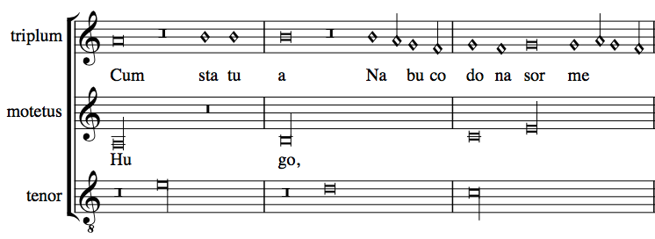
Examples: Perfect, Imperfect, Altered
Piece: Hugo
(Ivrea)
Verovio (Mensural)
Notes:
IN THIS PIECE THE LONG IS PERFECT BY DEFAULT
It is barred so that it can be easy to visualize where the perfections are
This long here, is perfect
THIS LONG DOES NOT OCUPY THE SAME SPACE
IT HAS THIS BREVE REST IN FRONT OF IT, THAT FORCES IT TO CHANGE ITS DEFAULT VALUE. IT IS IMPERFECT
2 BREVES BETWEEN LONGS → THE SECOND ONE GETS ALTERED (TWICE ITS VALUE)
And you can see that this altered breve occupies the same space as the imperfect long (because both of them are worth the same, even when they are two different notes)
So, as you can see, all the different three qualities of the notes: perfect, imperfect, and altered, are captured in the Mensural MEI file.

Slide 24
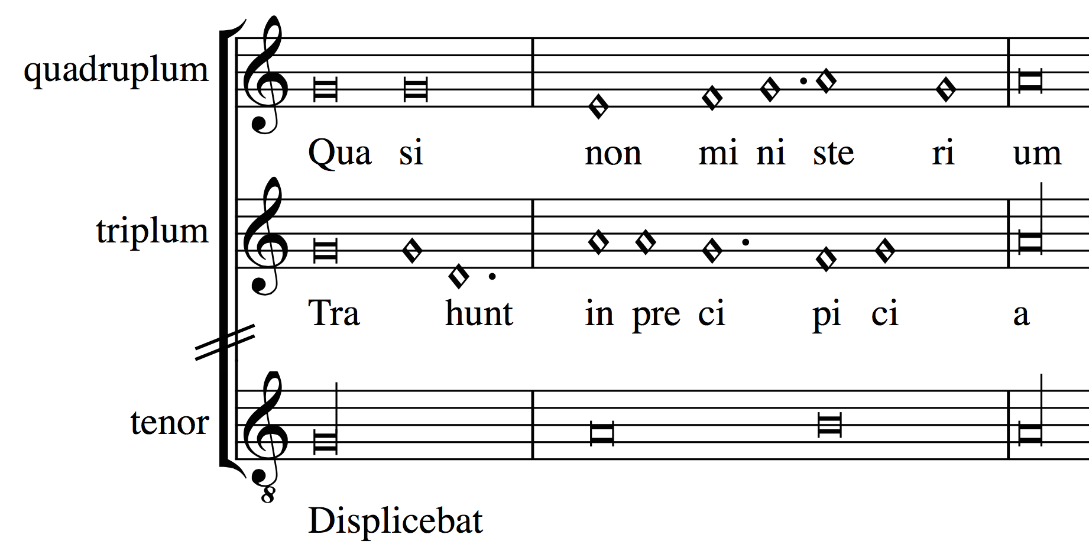
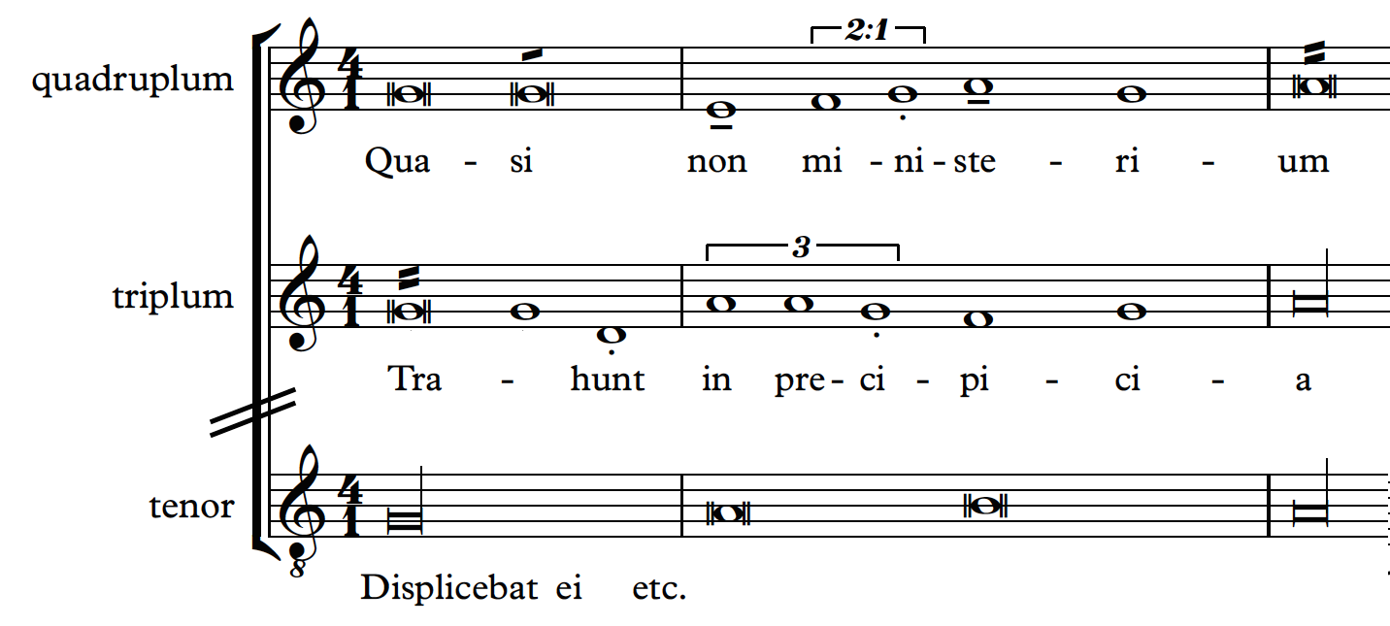
Examples: Minor and Major Semibreves
In ars antiqua pieces
Piece: Ve qui gregi
(Fauvel)
Verovio (Mensural)
Sibelius (CMN)
Notes:
The diamond notes are grouped by these dots here
When you have a group of 3, all the notes are interepreted as having the same duration
When you have a group of 2, the second one is always interpreted to be longer than the first one
(see, it occupies more space)
But if the composer wanted to revert this interpretation (i.e., if he wanted the first one to be longer than the second one)
He had to use…

Slide 25
Mensural MEI Translator
Python module
Parameters:
Piece
Style (Ars antiqua or Ars nova)
Mensuration of each voice
Notes:
This means that the translator can deal with voices with different mensurations
Out of the 64 pieces, 58 are completely translated into mensural values. We are currently working on implementing “coloration” and “changes in mensuration within a voice” to cover the whole set of pieces.

Slide 26
In Conclusion
Sibelius
file
(modern transcription)
CMN
MEI
file
Mensural
MEI
file
SibMEI
plugin
Mensural MEI
Translator
MusicXML
PDF
Printed editions
MIDI
Notes:
The last 2 steps, are done by the machine
The first is done by the musicologist
It can be facilitated, since we already have many modern transcriptions in …

Slide 27
In Conclusion
Streamlines the process for digitally encoding this repertory
Encodes the original medieval notation in a standardized machine-readable format
Searched or analyzed
Available to other websites and applications
The pieces can be displayed in Verovio
Freely available to performers, scholars, and the public
Notes:
VEROVIO !!!
A WEB-BASED, OPEN-SOURCE, RENDER ENGINE FOR MEI
1) streamlines the process for digitally encoding this repertory so that other stakeholders can easily and rapidly enlarge the dataset;
2) encodes the original medieval notation in a standardised machine-readable format so that it can be searched or analysed, and, through the interoperable format make this project’s data available to other websites and applications; and
3) the pieces can be displayed in Verovio, providing access to scored-up versions of this repertoire that retain the mensural notation features of the original manuscript sources, making them freely available to performers, scholars, and the public.
Most of the current encoding projects on early focus on repertories of plainchant (Cantus), or record repertories in modern notation formats (The Josquin Research Project). ‘Measuring Polyphony’ is the first project that encodes medieval music as it was originally notated, BY USING THIS METHODOLOGY
THE TRANSLATOR ITSELF IS INDEPENDENT OF SIBELIUS, IT CAN WORK WITH MODERN TRANSCRIPTIONS ENCODED IN CMN MEI (GIVEN THAT THEY FOLLOW PROF. DESMOND’S CONVENTIONS)

Slide 28




Thank you!
https://github.com/DDMAL/CMN-MEI_to_MensuralMEI_Translator

